Slide 1
Modeling the Domain with Responsibility-Driven Design
Ian Cooper
@ICooper
Notes:
Welcome the audience. Introduce yourself and give a brief overview of the talk. Set expectations for what they'll learn.

Slide 2
Who Are You?
I am a polyglot coding architect with over 20 years of experience delivering solutions in government, healthcare, and finance and ecommerce. During that time I have worked for the DTI, Reuters, Sungard, Misys, Beazley, Huddle and Just Eat Takeaway delivering everything from bespoke enterprise solutions, 'shrink-wrapped' products for thousands of customers, to SaaS applications for hundreds of thousands of customers. I am an experienced systems architect with a strong knowledge of OO, TDD/BDD, DDD, EDA, CQRS/ES, REST, Messaging, Design Patterns, Architectural Styles, ATAM, and Agile Engineering Practices I am frequent contributor to OSS, and I am the owner of: https://github.com/BrighterCommand. I speak regularly at user groups and conferences around the world on architecture and software craftsmanship. I run public workshops teaching messaging, event-driven and reactive architectures. I have a strong background in C#. I spent years in the C++ trenches. I dabble in Go, Java, JavaScript and Python.
www.linkedin.com/in/ian-cooper-2b059b
Notes:
Walk through the agenda briefly. Let the audience know we'll get practical and example-driven.
Outline of the talk (sections as bullets):
DDD to RDD: What’s missing, and where RDD fits
Key ideas: responsibilities, roles, collaborations
THE EXAMPLE: Modeling with CRC cards in practice
RDD’s place in modern development: DDD, TDD, and agility

Slide 3


Slide 4
Agenda
RDD: The Key to DDD
RDD Revisited
Applying RDD
RDD Today
Notes:
Walk through the agenda briefly. Let the audience know we'll get practical and example-driven.
Outline of the talk (sections as bullets):
DDD to RDD: What’s missing, and where RDD fits
Key ideas: responsibilities, roles, collaborations
THE EXAMPLE: Modeling with CRC cards in practice
RDD’s place in modern development: DDD, TDD, and agility

Slide 5
RDD: The Key to DDD
How were you ever able to do DDD without it?

Slide 6
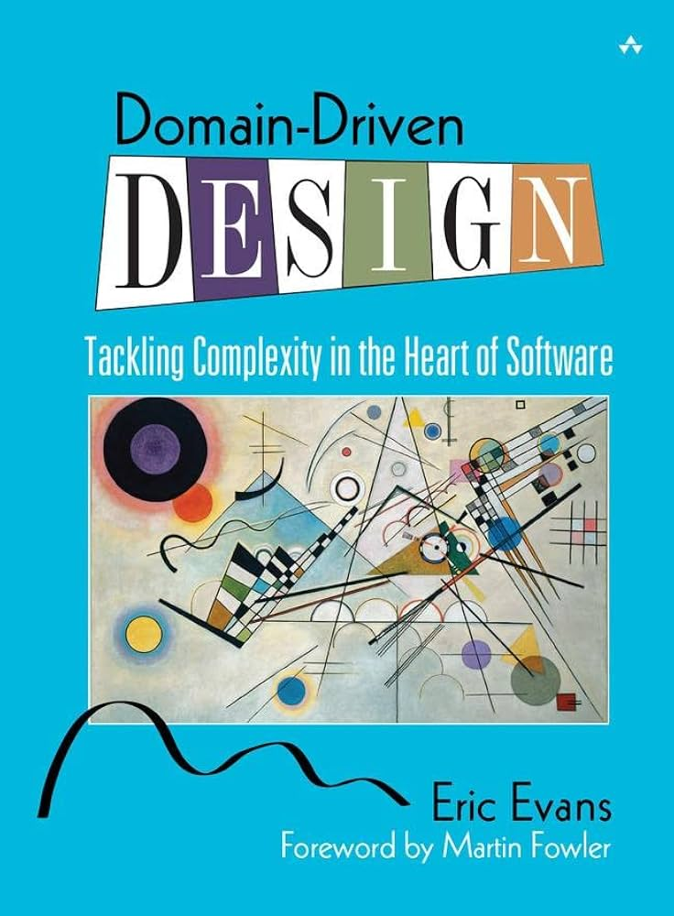
What DDD Asks of Us
Focus on the Domain Model and not the Application Model when modelling.
Isolate the Domain Model from Application concerns
Layers/Ports & Adapters
Strategic Design
Create a Ubiquitous Language and use it in the Domain Model
Model is expressed at all levels
Conversations, Analysis, Design
Analysis and Design models are not different
2004
Notes:
Explain that while DDD focuses on language and boundaries, it gives little concrete guidance on building the object model.
Teach: DDD says model the domain, focus on ubiquitous language, core concepts, etc.
But it stops short of showing how to turn insight into object design
Quote Evans (paraphrased): “The domain model is central, but building one is an art”

Slide 7
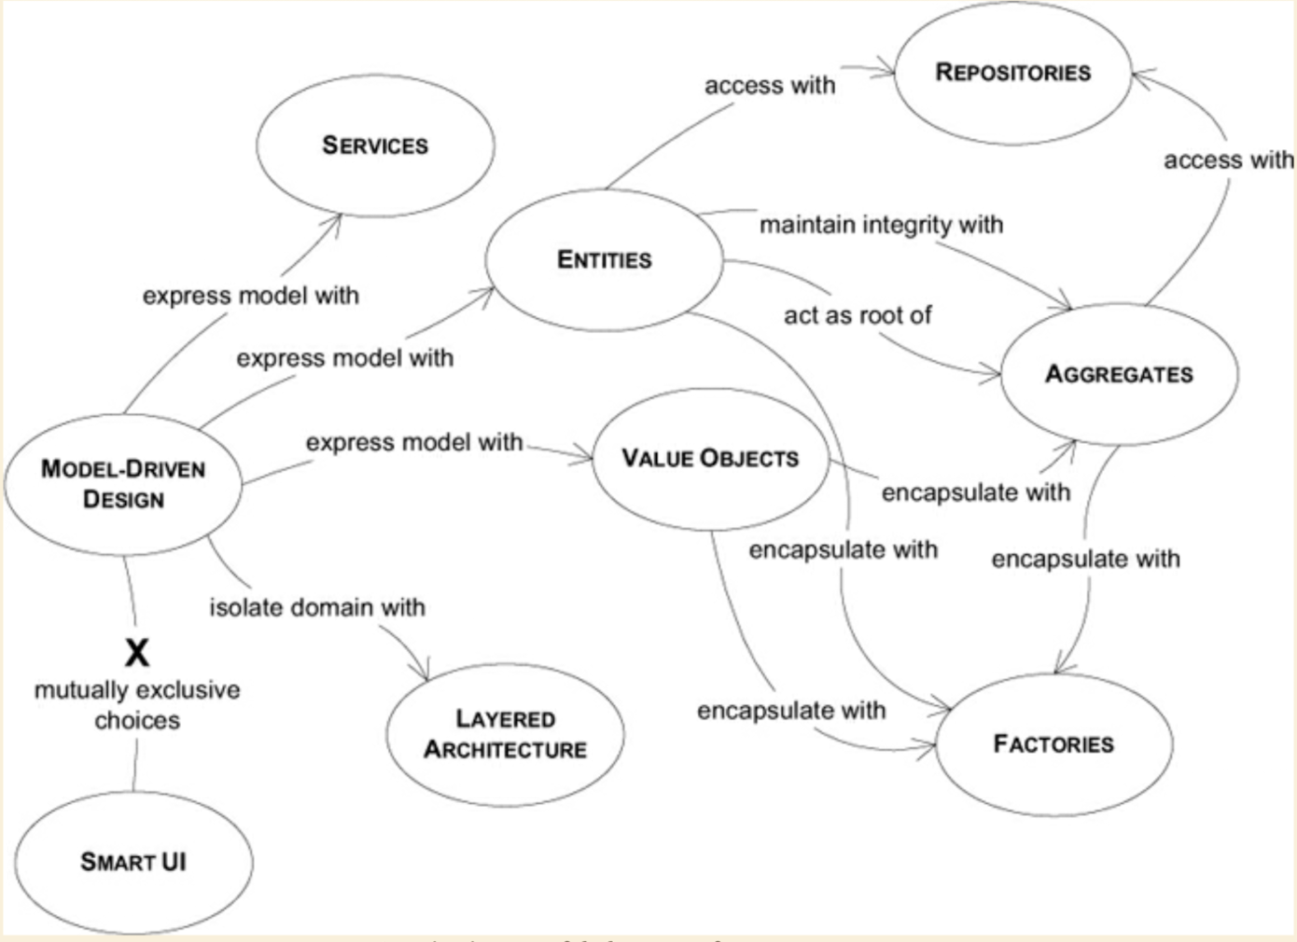
Modelling: What DDD Offers
Entities, Value Objects, Aggregates, Repositories, Factories, Services
Eric, Evans. Domain-Driven Design: Tackling Complexity in the Heart of Software
Notes:
List the building blocks DDD gives us—aggregates, entities, etc.—but note they are not techniques for modeling behavior.
Teach: DDD provides:
Aggregates
Entities and Value Objects
Repositories, Services
These help organize or abstract—but not build the model itself
Emphasize: these are structural, not behavioral, modeling tools

Slide 8
What DDD Doesn’t Offer
Most of these concepts express the lifetime of a domain object
Born in a factory, lives in a repository
Comparable by identity or value
Preserves invariants
But how do we model a domain as objects, beyond lifetime or consistency issues?
DDD remains curiously silent
Eric, Evans. Domain-Driven Design: Tackling Complexity in the Heart of Software
Notes:
List the building blocks DDD gives us—aggregates, entities, etc.—but note they are not techniques for modeling behavior.
Teach: DDD provides:
Aggregates
Entities and Value Objects
Repositories, Services
These help organize or abstract—but not build the model itself
Emphasize: these are structural, not behavioral, modeling tools

Slide 9
The Modeling Gap
But how do we use objects to model a domain?
DDD emphasizes the domain, but lacks modelling guidance
Common fallback: data modelling, class-first, framework-driven
Look for the NOUNS?
Notes:
This quote makes the case that RDD addresses a real challenge in moving from requirements to objects:
“Responsibility-Driven Design is a clarification process. We move from initial requirements to initial descriptions and models; from initial descriptions to more detailed descriptions and models of objects.” — Object Design, p. 31 Highlight the missing step: identifying domain behavior and how to distribute it across objects.
Teach: There’s a missing piece between “talk to the domain experts” and “design an object model”
Set up the central question: How do we find the objects and responsibilities of our domain?
You might contrast with this comment on how users and developers interact with domain concepts:
“Given that users and experts are familiar with these domain concepts, they can discuss these aspects of the application easily. … For the developers, these domain objects are only the starting point for constructing a model of the domain.” — Object Design, p. 6

Slide 10
The Nouns Problem
Object Oriented Programming puts the Nouns first and foremost. Why would you go to such lengths to put one part of speech on a pedestal? Why should one kind of concept take precedence over another? It's not as if OOP has suddenly made verbs less important in the way we actually think. It's a strangely skewed perspective. As my friend Jacob Gabrielson once put it, advocating Object-Oriented Programming is like advocating Pants-Oriented Clothing.
https://steve-yegge.blogspot.com/2006/03/execution-in-kingdom-of-nouns.html
Notes:
This quote makes the case that RDD addresses a real challenge in moving from requirements to objects:
“Responsibility-Driven Design is a clarification process. We move from initial requirements to initial descriptions and models; from initial descriptions to more detailed descriptions and models of objects.” — Object Design, p. 31 Highlight the missing step: identifying domain behavior and how to distribute it across objects.
Teach: There’s a missing piece between “talk to the domain experts” and “design an object model”
Set up the central question: How do we find the objects and responsibilities of our domain?
You might contrast with this comment on how users and developers interact with domain concepts:
“Given that users and experts are familiar with these domain concepts, they can discuss these aspects of the application easily. … For the developers, these domain objects are only the starting point for constructing a model of the domain.” — Object Design, p. 6

Slide 11
DDD: OO Design Style
The design style in this book largely follows the principle of “responsibility-driven design,” put forward in Wirfs-Brock et al. 1990 and updated in Wirfs-Brock 2003.
Eric, Evans. Domain-Driven Design: Tackling Complexity in the Heart of Software
Notes:
Quote Evans to validate RDD as part of DDD’s heritage. This isn’t an alternative—it’s foundational.
Teach: DDD explicitly builds on RDD
Quote Evans (Chapter 5) crediting Wirfs-Brock for responsibility modeling
Emphasize: the connection is canonical, not inferred
This slide can include a direct quote from Domain-Driven Design (which you may want to include manually), such as:
“Responsibility-driven design is an approach that focuses on the behavior of objects. I have found the responsibility-driven approach very helpful.” — Eric Evans, Domain-Driven Design, Chapter 5

Slide 12
RDD Revisited
Behavior Driven OO Analysis and Design

Slide 13
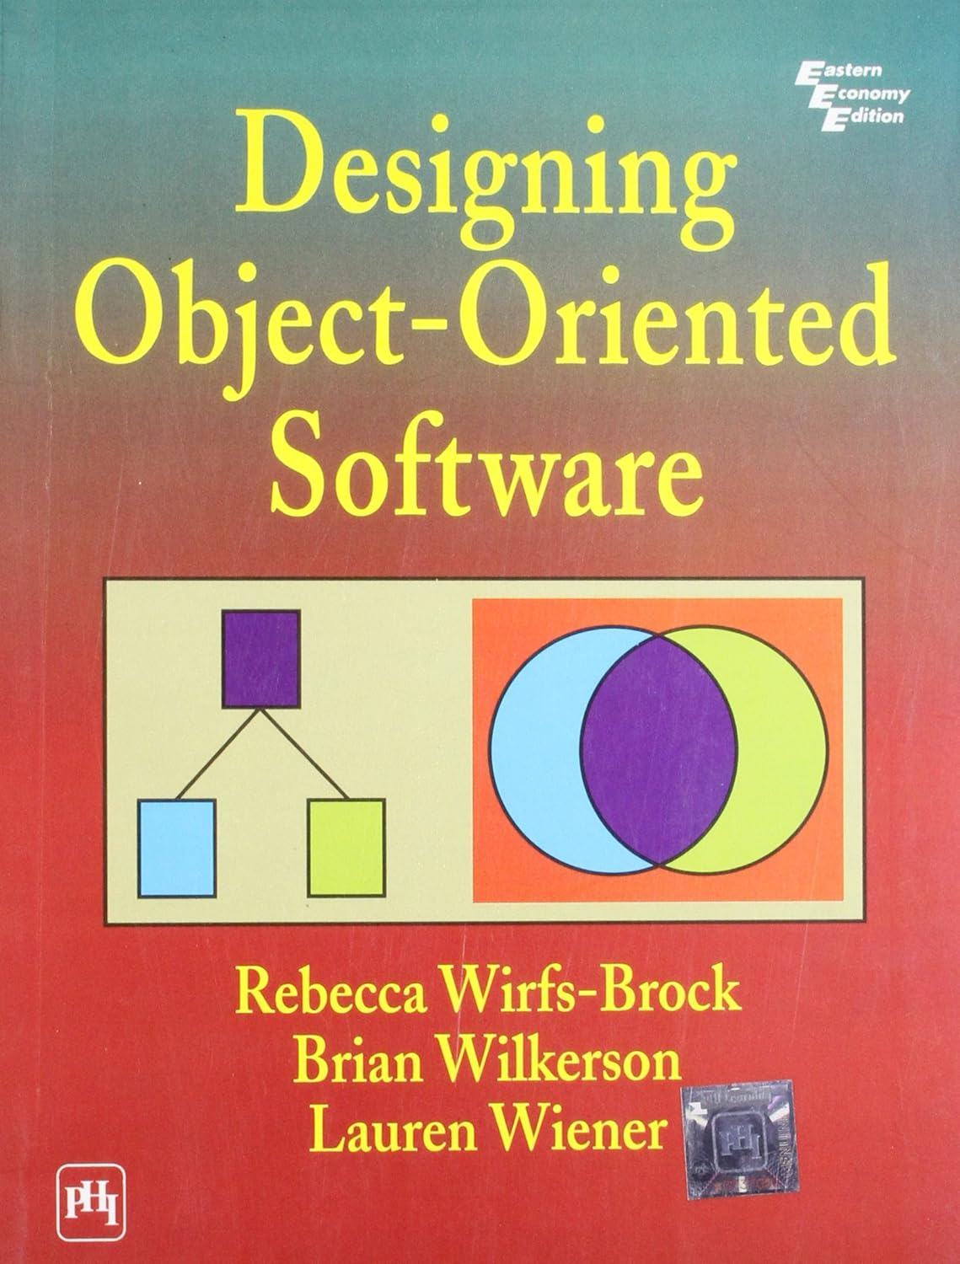
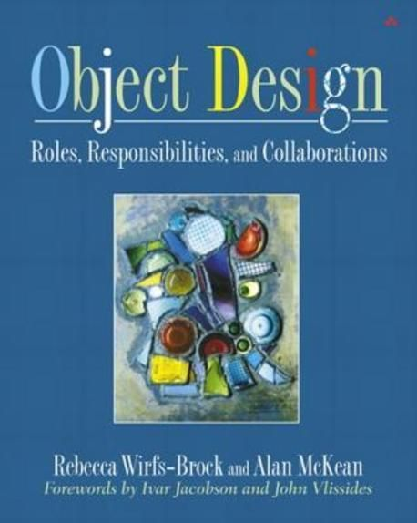
Responsibility-Driven Design
Responsibility-Driven Design (RDD) was first described in a paper by Rebecca Wirfs-Brock and Brian Wilkerson, ‘Object-Oriented Design: A Responsibility-Driven Approach,’ presented at the OOPSLA ’89 Conference.
1990
2003
Notes:
Introduce RDD and Rebecca Wirfs-Brock. Explain its focus on behavior, roles, and collaboration.
Teach: RDD is the missing modeling method
Introduce Rebecca Wirfs-Brock and the origins of RDD
Emphasize: RDD predates DDD but complements it perfectly
Use this quote to anchor RDD’s origins:
“Responsibility-Driven Design was first described in a paper by Rebecca Wirfs-Brock and Brian Wilkerson, ‘Object-Oriented Design: A Responsibility-Driven Approach,’ presented at the OOPSLA ’89 Conference.” — Object Design, p. 58

Slide 14
What Is Responsibility-Driven Design?
Responsibility-driven design specifies object behavior before object structure and other implementation considerations are determined. We have found that it minimizes the rework required for major design changes.
Wirfs-Brock, R. and Wilkerson, B. (1989) ‘Object-oriented design: A responsibility-driven approach’, Conference proceedings on Object-oriented programming systems, languages and applications, pp. 71–75. doi:10.1145/74877.74885.
Notes:
Introduce RDD’s key concept: designing objects by their responsibilities, not structure.
Teach that RDD is a way to think about objects as responsible agents
Core idea: assign responsibilities rather than start from data or types
Emphasize: Responsibilities over structure

Slide 15
RDD Principles
Maximise Abstraction
Elide the distinction between data and behaviour.
Think of responsibilities for “knowing”, “doing”, and “deciding”
Distribute Behaviour
Promote a delegated control architecture
Make objects smart— give them behaviours, not just data
Preserve Flexibility
Design objects so interior details can be readily changed.
Notes:
Introduce RDD and Rebecca Wirfs-Brock. Explain its focus on behavior, roles, and collaboration.
Teach: RDD is the missing modeling method
Introduce Rebecca Wirfs-Brock and the origins of RDD
Emphasize: RDD predates DDD but complements it perfectly
Use this quote to anchor RDD’s origins:
“Responsibility-Driven Design was first described in a paper by Rebecca Wirfs-Brock and Brian Wilkerson, ‘Object-Oriented Design: A Responsibility-Driven Approach,’ presented at the OOPSLA ’89 Conference.” — Object Design, p. 58

Slide 16
Modelling with Objects
An application – a set of interacting objects
An object – an implementation of one or more roles
A role – a set of related responsibilities that can be used interchangeably
A responsibility – an obligation to perform a task or know information
A collaboration – an interaction of roles (or both)
A contract – an agreement outlining the terms of a collaboration
Wirfs-Brock, R. and McKean, A. (2002). Object design: Roles, responsibilities, and collaborations. Boston, Mass: Addison-Wesley.
Notes:
Explain that while DDD focuses on language and boundaries, it gives little concrete guidance on building the object model.
Teach: DDD says model the domain, focus on ubiquitous language, core concepts, etc.
But it stops short of showing how to turn insight into object design
Quote Evans (paraphrased): “The domain model is central, but building one is an art”

Slide 17
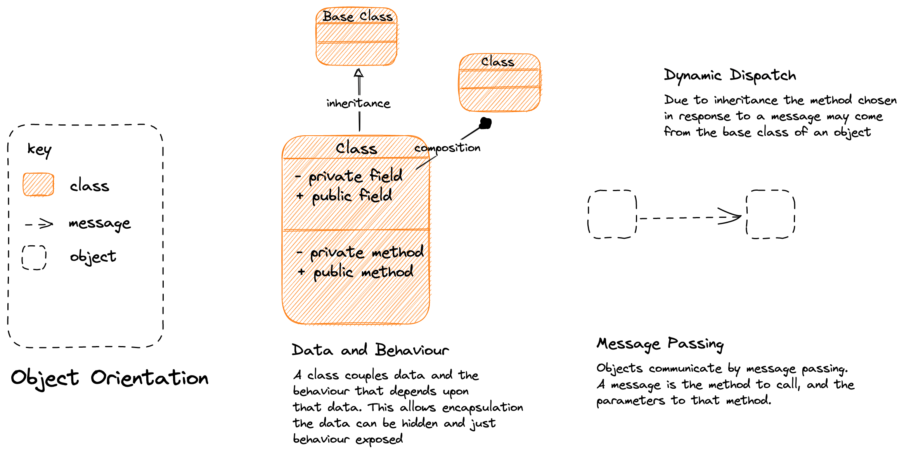
What is an Object?
Notes:
An object defines its responsibilities in an interface. An object sets terms and conditions for use of that interface and implements it.
An object uses information hiding, it hides the details of how it provides the service
A class is a factory for creating objects; it may also provide services directly.
Two types of relationship: inheritance and composition
Domain objects represent concepts that which are familiar to users and experts in a specified field
Application-Specific Objects translate inputs and outputs to the domain objects

Slide 18
What Is a Responsibility?
Forms the behavioral contract of an object
We define responsibilities as:
Knowing something
Doing something
Deciding something
Responsibilities ≠ methods, but they inspire them
Notes:
Define responsibilities as knowing, doing, and deciding. These form the behavioral contract of an object.
Define responsibilities as:
Knowing something
Doing something
Deciding something
Clarify: responsibilities ≠ methods, but they inspire them
Mention: responsibilities form the behavioral contract of an object

Slide 19
What Is a Role?
Set of related responsibilities
Abstraction targeted by a collaboration
A role can be used interchangeably
Multiple objects can play a role
An object may have multiple roles
May be expressed as an abstract type or interface
Stereotypes represent structural roles
A useful shorthand for objects that have a particular role in an application
Not domain roles though, so look for those too
Notes:
Roles are sets of responsibilities. Multiple objects can play a role. Think in terms of the job, not the actor.
A role is a set of related responsibilities
Emphasize: roles provide abstraction and interchangeability
Multiple objects can play the same role; one object can play multiple roles
Analogy: actors in a play

Slide 20
Object Stereotypes
Information Holder – knows and provides/calculates information.
Aggregates, Command, Data Transfer Objects, Domain Event, Entities, Measurement, Model, Value Objects
Structurer - maintains relationships between objects and information about those relationships
Aggregates, Collections, Repository
Service Provider – performs work and, in general, provides computing services.
Domain Services, Entities, Factory, Parser, Repository, Request Handlers, Value Objects
Notes:
Stereotypes guide how we think about an object's job. Use them to clarify modeling choices.
Introduce the 6 common object role stereotypes:
Information Holder – knows and provides information
Structurer - maintains relationships between objects and information about those relationships
Service Provider – performs work and, in general, provides computing services
Coordinator – reacts to events by delegating tasks to others
Controller – makes decisions and closely directs others' actions
Interfacer – transforms information between distinct parts of the system
Teach: stereotypes guide how we characterize candidate objects
Possibly group into passive (holders) vs active (doers/deciders)

Slide 21
Object Stereotypes
Coordinator – reacts to events by delegating tasks to others
Message Pump, Pool, Request Dispatcher, Request Processor, Supervisor
Controller – makes decisions and closely directs others' actions
Mediator, Router, State Machine, Workflow
Interfacer – transforms information between distinct parts of the system
Façade, Form, Gateway, Sensor, View, Web Page
Notes:
Stereotypes guide how we think about an object's job. Use them to clarify modeling choices.
Introduce the 6 common object role stereotypes:
Information Holder – knows and provides information
Structurer - maintains relationships between objects and information about those relationships
Service Provider – performs work and, in general, provides computing services
Coordinator – reacts to events by delegating tasks to others
Controller – makes decisions and closely directs others' actions
Interfacer – transforms information between distinct parts of the system
Teach: stereotypes guide how we characterize candidate objects
Possibly group into passive (holders) vs active (doers/deciders)

Slide 22
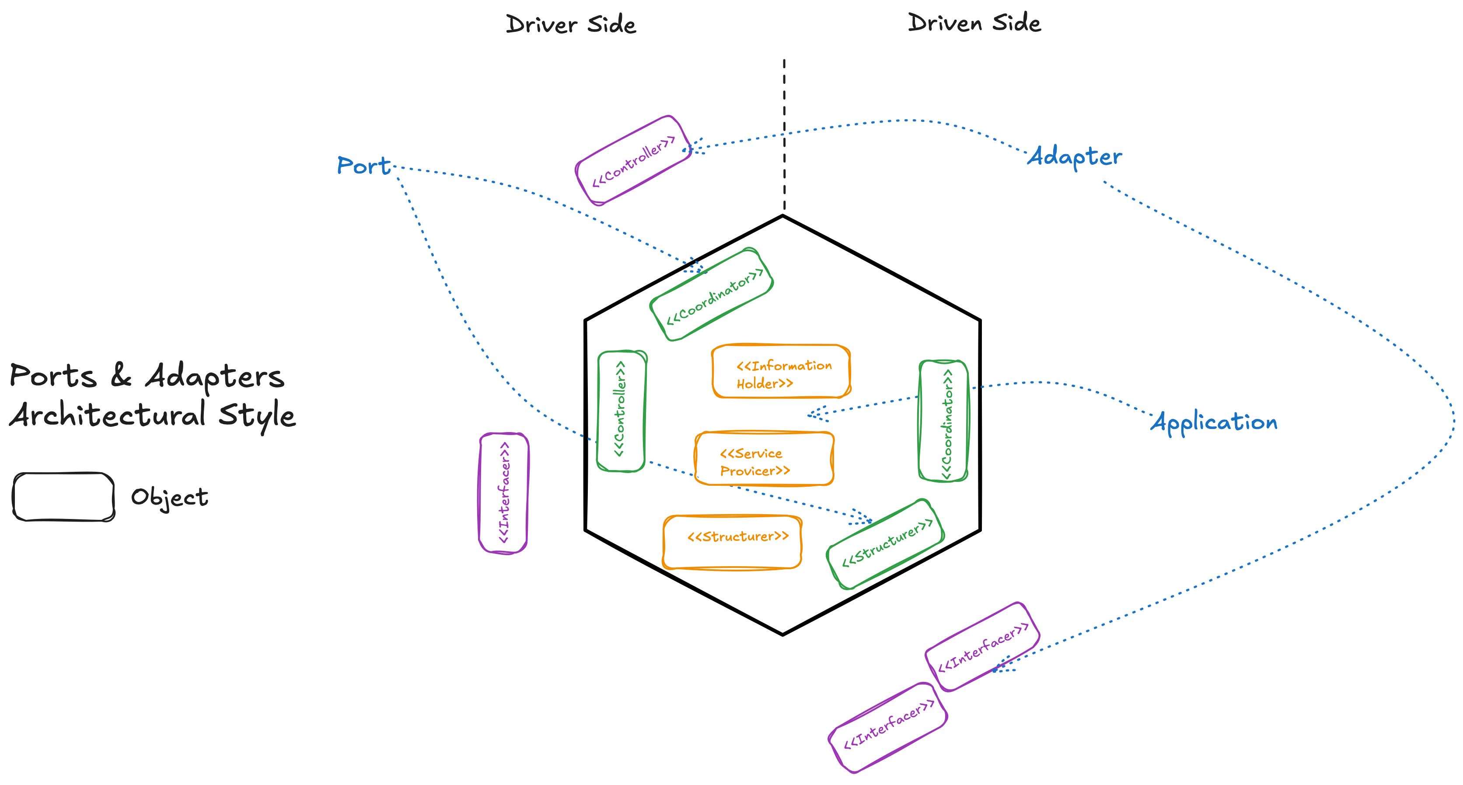
Object Stereotypes

Slide 23
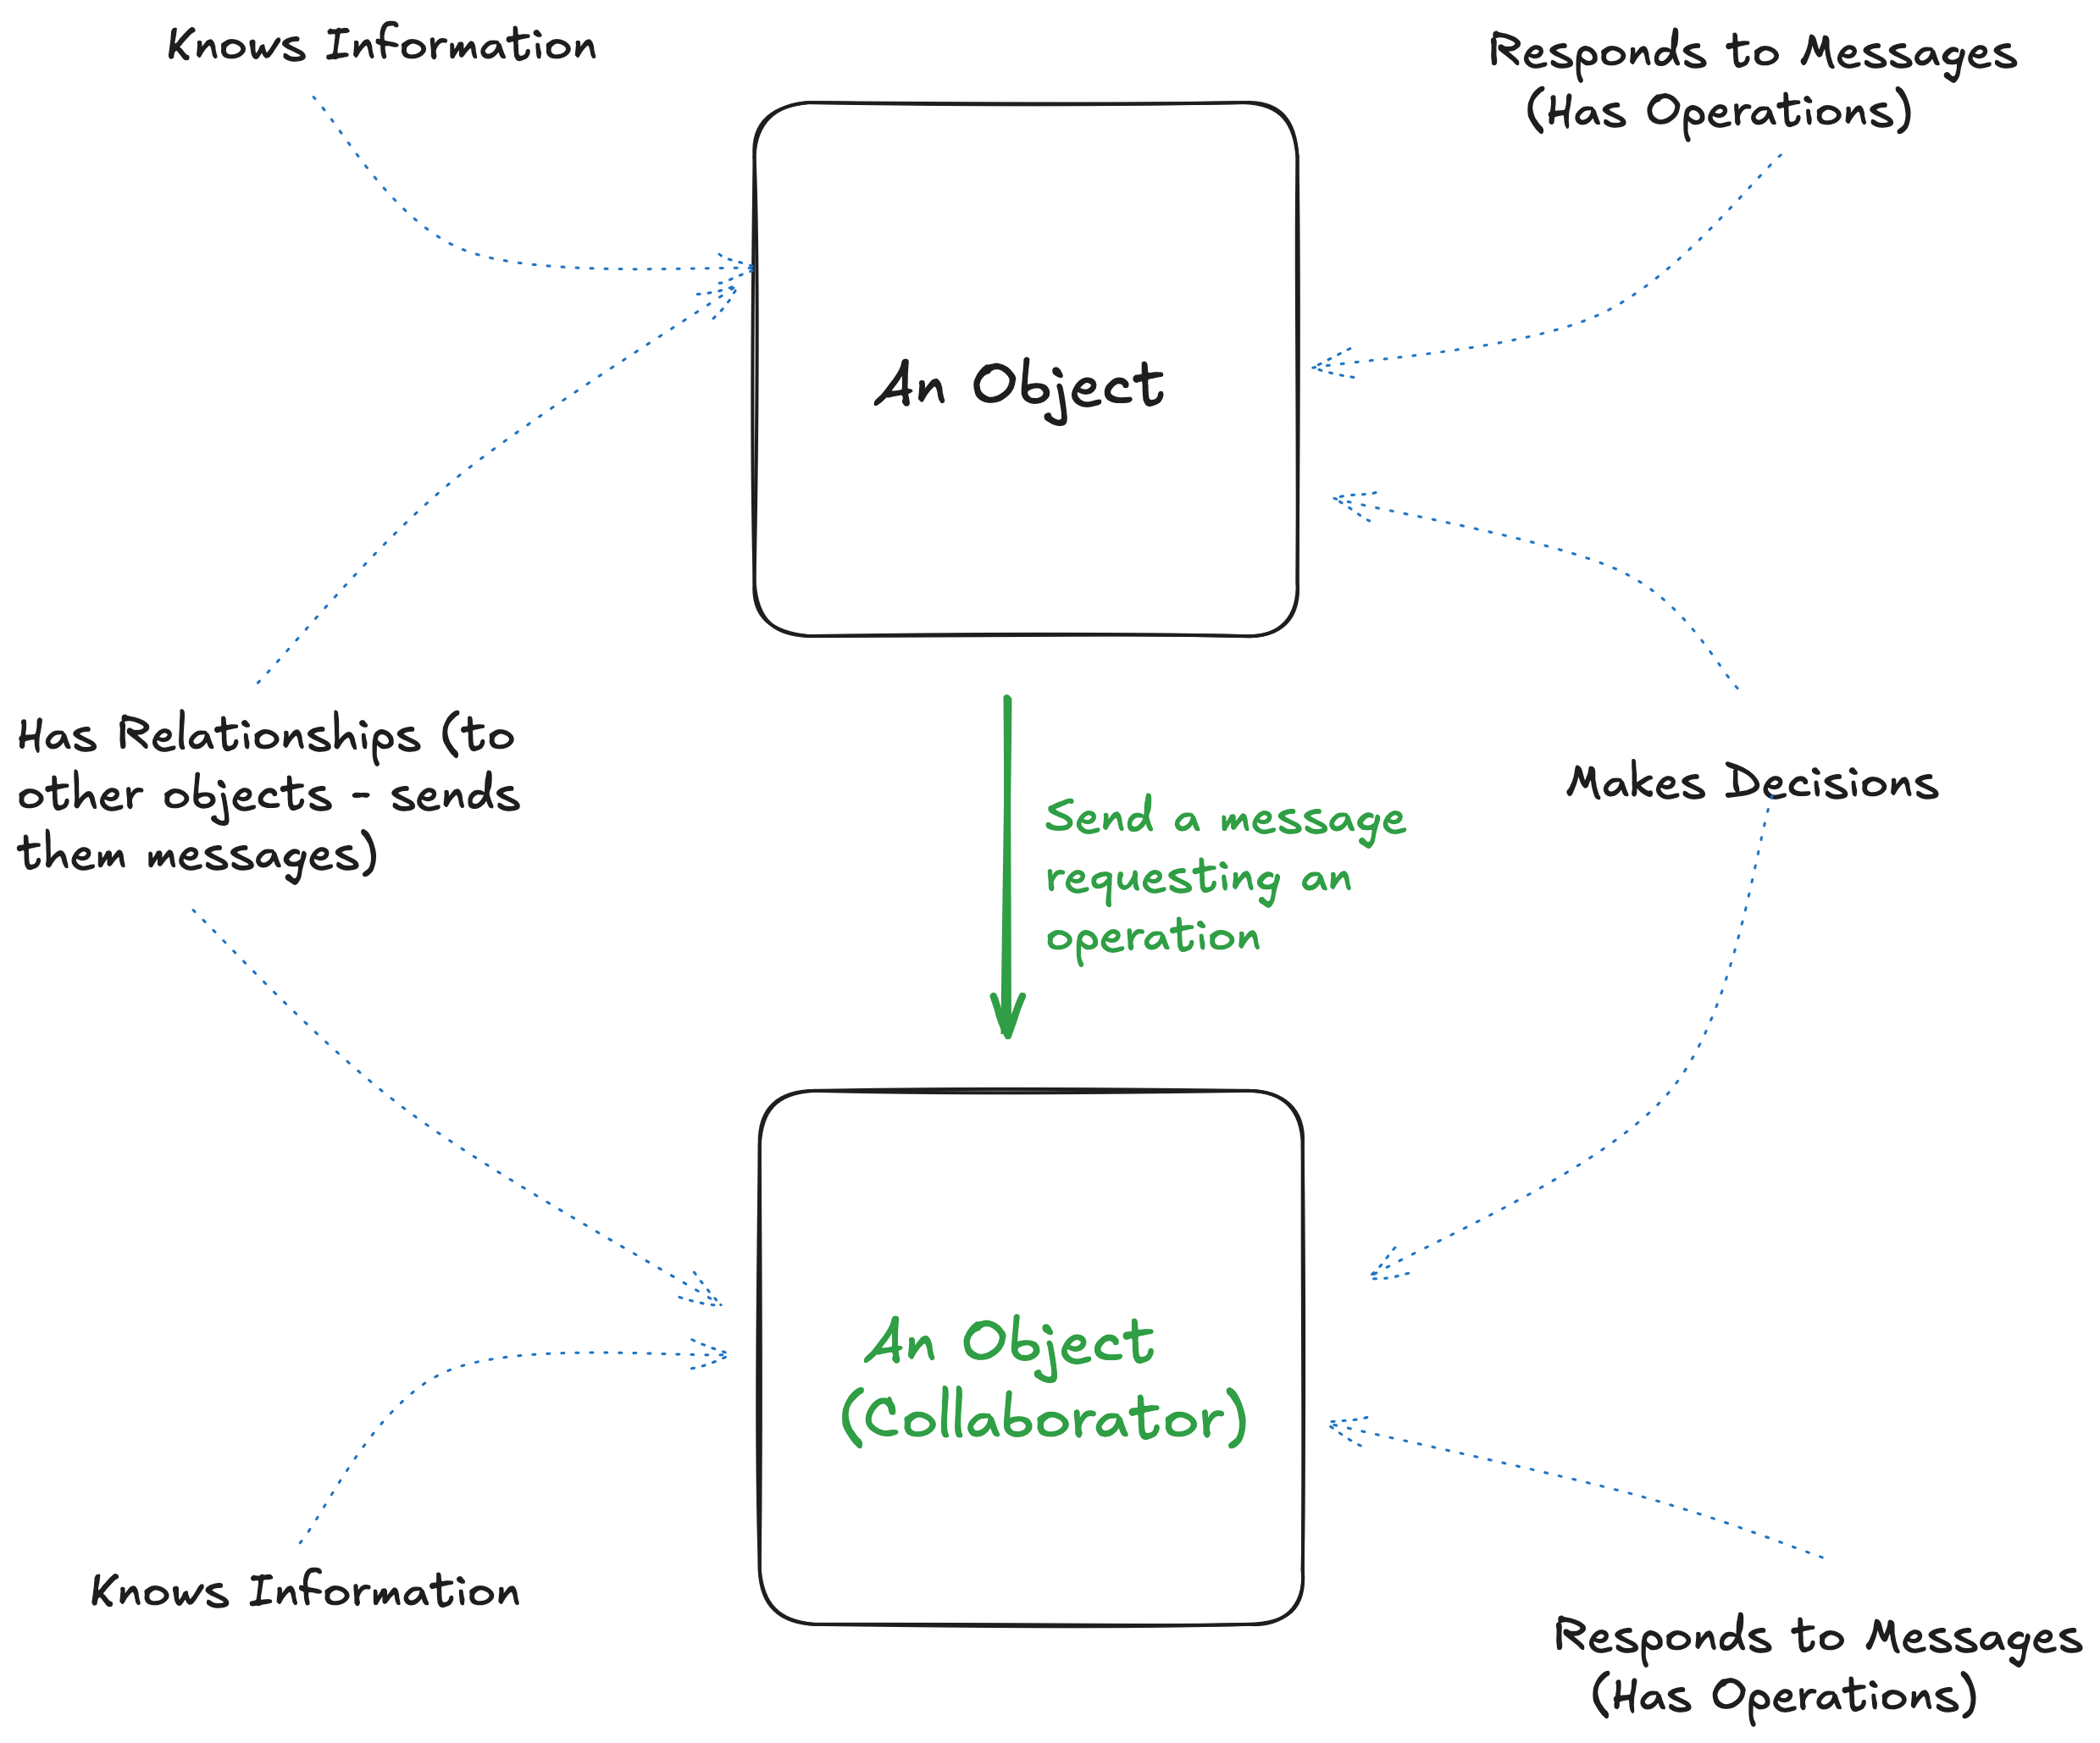
Collaboration
Notes:
Objects work together to fulfill responsibilities. Collaboration is core to expressive OO design.
Teach that objects collaborate to fulfill system responsibilities
Responsibilities are fulfilled in concert, not isolation
Introduce the RDD mantra: “Objects do things for other objects”
Brief example: what collaboration might look like in THE EXAMPLE

Slide 24
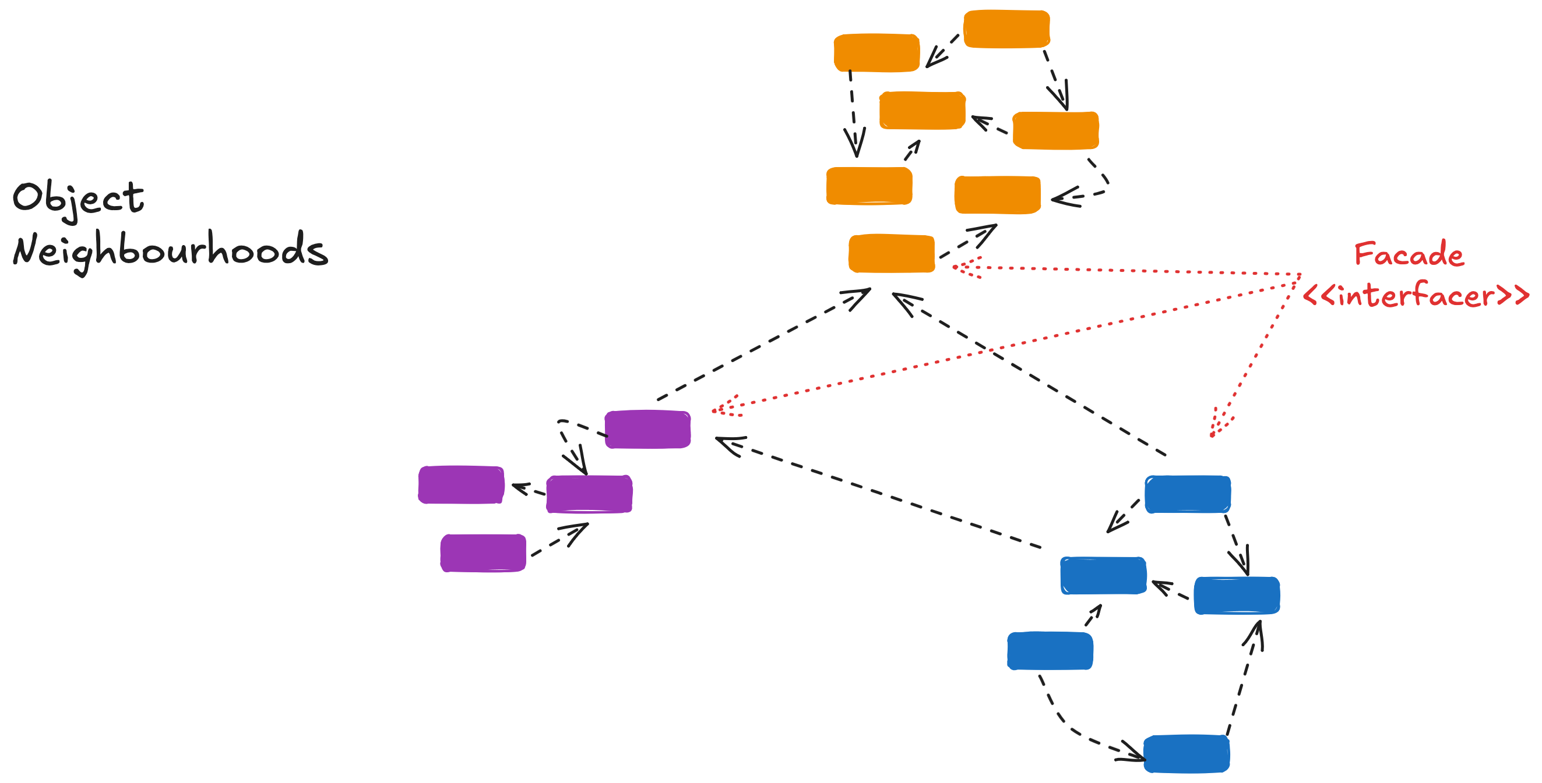
Object Neighborhoods
Notes:
Think of software as a neighborhood—objects cooperating with clear boundaries and purposes.
Teach the metaphor of software as a community of collaborating objects
Objects fit into neighborhoods, with clear communication lines
This helps manage complexity and maintainability
Objects form cooperating clusters
Supports separation of concerns and communication patterns

Slide 25
What Is a Contract?
“The ways in which a given client can interact with a given server are described by a contract. A contract is the list of requests that a client can make of a server. Both must fulfill the contract: the client by making only those requests the contract specifies, and the server by responding appropriately to those requests. …For each such request, a set of signatures serves as the formal specification of the contract.”
—Wirfs-Brock, Wilkerson & Wiener, Designing Object Oriented Software
Preconditions and Postconditions
Behavioral agreement—not just types
Notes:
Contracts are preconditions and postconditions—behavioral guarantees—not just method signatures.
Teach: a contract expresses preconditions (conditions of use) and postconditions (aftereffects)
Not formal types or interfaces—these are design-level behavioral agreements
Explain how contracts help reason about correctness and trust boundaries

Slide 26
Contracts
A class that all its clients view identically offers a single contract
A class that inherits a contract should support it in its entirety.
It should not cancel out any behaviour.
A subclass may extend a superclass by adding new responsibilities and defining new contracts.
A class that is viewed differently by clients can offer multiple contracts.

Slide 27
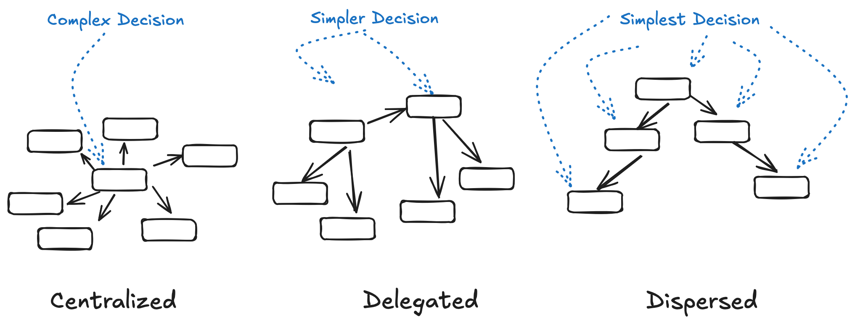
Control Styles
Notes:
Explain the control patterns—centralized, dispersed, delegated—and how they shape object collaboration.
Teach the 3 main control styles:
Centralized (1 object makes decisions)
Dispersed (logic spread out)
Delegated (objects ask others for help)
Emphasize: control style affects collaboration patterns and changeability
Optional: quick visual comparison

Slide 28
Key RDD Concepts
Responsibilities
Roles
Stereotypes
Collaborations
Contracts
Control Styles
Notes:
Reinforce the core ideas covered so far. Set up the transition to a practical example.
Reinforce:
Responsibilities
Roles
Stereotypes
Collaborations
Contracts
Control Styles
Bridge to next section: now that we understand the theory, let’s see RDD in practice with THE EXAMPLE

Slide 29
Applying RDD
How Do You Do This?

Slide 30
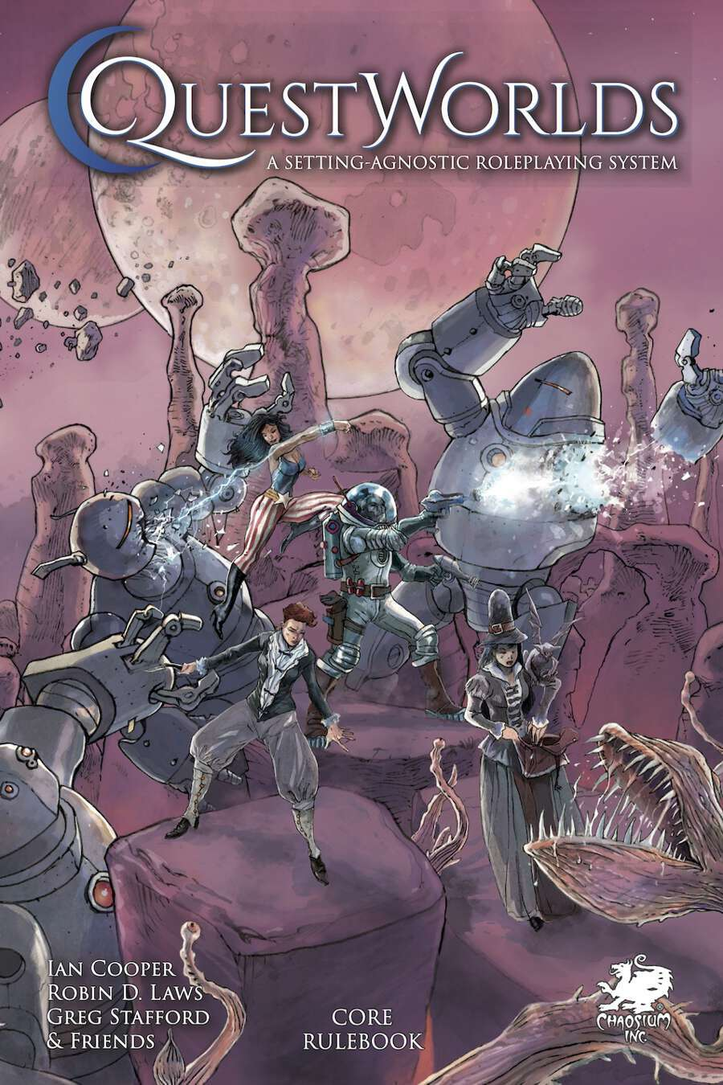
A QuestWorlds Contest Runner
Example domain
It has several procedures, but for this exercise, we will focus on modelling its simple resolution engine: contests.
https://www.drivethrurpg.com/en/product/509287/questworlds
Notes:
Briefly describe a website that runs one-on-one QuestWorlds contests. Clarify we're modeling a slice of behavior, not a full app.
Teach: Briefly describe the domain problem we’ll model
Emphasize: This is not a full app design—just the core of the domain behavior
Frame the scope: one or two user goals or system responsibilities

Slide 31
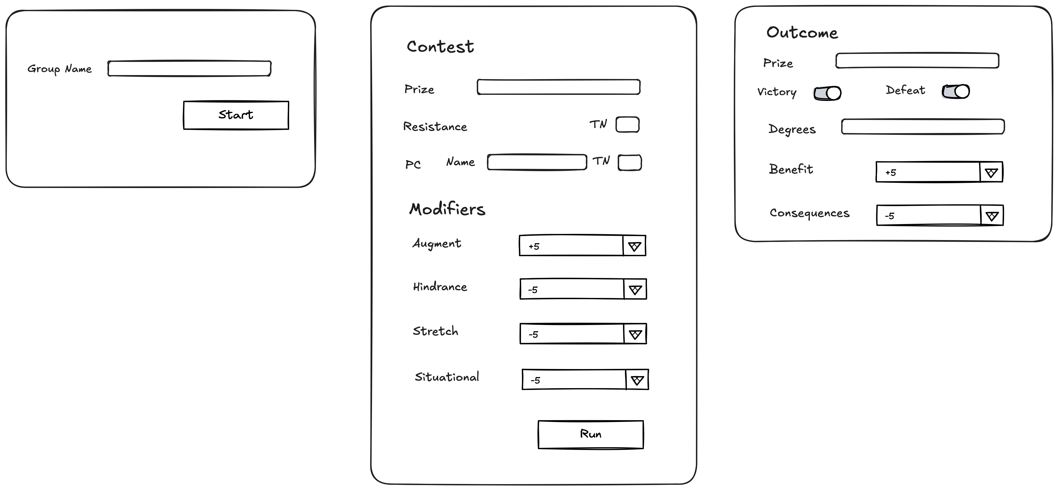
https://www.drivethrurpg.com/en/product/509287/questworlds
Notes:
Briefly describe a website that runs one-on-one QuestWorlds contests. Clarify we're modeling a slice of behavior, not a full app.
Teach: Briefly describe the domain problem we’ll model
Emphasize: This is not a full app design—just the core of the domain behavior
Frame the scope: one or two user goals or system responsibilities

Slide 32
Step 1 – Write a Design Story
A design story is a narrative about the system’s behaviour
Focus on:
Who’s involved
What they want to do
How the system supports them
Think like a script, not a spec
Example structure: “When ___ wants to ___, the system should ___.”
Notes:
Write a short narrative of user/system interaction. This grounds your model in real behavior.
Write a design story, describing important feature of your application
Identify major themes and concerns
Search for candidate objects that surround and support each theme
Check that they are key concepts of the domain or how your domain interacts with the outside world
Look for candidates that represent additional mechanisms or machinery
Name, describe and characterise each candidate
Organize candidates into neighbourhoods
Check appropriateness of abstractions
Defend inclusion

Slide 33
Step 1 – Write a Design Story
A GM wants to run a QuestWorlds contest with a player. They open the QuestWorlds website and generate a session ID, which they share with their players. The GM creates a new contest by entering the prize and setting the Target Number for the resistance. A player joins the session and records an ability they believe will help them overcome the obstacle and its rating. The GM determines any stretch, situational modifiers, hindrances, and augments. The system rolls a D20 for both the GM. The system evaluates the results, adjudicates the winner, and determines possible consequences or benefits. The outcome is shared with the GM and the Player.
Notes:
Write a short narrative of user/system interaction. This grounds your model in real behavior.

Slide 34
Step 2 – Identify Themes
Pull out recurring or significant behavioural themes
Wirfs-Brock, R. and McKean, A. (2002). Object design: Roles, responsibilities, and collaborations. Boston, Mass: Addison-Wesley.
Notes:
Write a short narrative of user/system interaction. This grounds your model in real behavior.
Write a design story, describing important feature of your application
Identify major themes and concerns
Search for candidate objects that surround and support each theme
Check that they are key concepts of the domain or how your domain interacts with the outside world
Look for candidates that represent additional mechanisms or machinery
Name, describe and characterise each candidate
Organize candidates into neighbourhoods
Check appropriateness of abstractions
Defend inclusion

Slide 35
Step 2 – Identify Themes
Within themes, look for candidates based on perspectives
The work your system performs
Things directly affected by or connected to the application (other software, physical machinery, hardware devices)
Information that flows through your software
Decision-making, control, and coordination activities
Structures and groups of objects
Representations of real-world things that the application needs to know something about
Wirfs-Brock, R. and McKean, A. (2002). Object design: Roles, responsibilities, and collaborations. Boston, Mass: Addison-Wesley.
Notes:
Write a short narrative of user/system interaction. This grounds your model in real behavior.
Write a design story, describing important feature of your application
Identify major themes and concerns
Search for candidate objects that surround and support each theme
Check that they are key concepts of the domain or how your domain interacts with the outside world
Look for candidates that represent additional mechanisms or machinery
Name, describe and characterise each candidate
Organize candidates into neighbourhoods
Check appropriateness of abstractions
Defend inclusion

Slide 36
Step 2 – Identify Themes
Theme | Perspective | Candidates
Session creation: Facilitating temporary, shareable play spaces | The work our system performs Structures and groups of objects Information that flows through the system
Contest Framing: creating the details of a contest | The work our system performs Information that flows through the system
Dice Rolling: emulating rolling the dice | The work our system performs Information that flows through the system
Adjudication: determining the result by rolling the dice | The work our system performs Information that flows through the system
Notes:
Write a short narrative of user/system interaction. This grounds your model in real behavior.
Write a design story, describing important feature of your application
Identify major themes and concerns
Search for candidate objects that surround and support each theme
Check that they are key concepts of the domain or how your domain interacts with the outside world
Look for candidates that represent additional mechanisms or machinery
Name, describe and characterise each candidate
Organize candidates into neighbourhoods
Check appropriateness of abstractions
Defend inclusion

Slide 37
Step 3 – Find Candidates
Start naming candidate objects & roles, not classes.
Describe candidates by what they do, not how they’re implemented
Encourage candidate names that reflect behaviour or responsibility
Don't include patterns, etc, in names
For services, look for verbs, doing words
Names should encompass what it does
Names should make sense across their lifecycle
Don't duplicate
Use adjectives to disambiguate
Use synonyms if needed
When using DDD, focus on names from your ubiquitous language.
Notes:
Write a short narrative of user/system interaction. This grounds your model in real behavior.
Write a design story, describing important feature of your application
Identify major themes and concerns
Search for candidate objects that surround and support each theme
Check that they are key concepts of the domain or how your domain interacts with the outside world
Look for candidates that represent additional mechanisms or machinery
Name, describe and characterise each candidate
Organize candidates into neighbourhoods
Check appropriateness of abstractions
Defend inclusion

Slide 38
Step 3 – Find Candidates
Theme | Perspective | Candidates
Session creation: Facilitating temporary, shareable play spaces | The work our system performs Structures and groups of objects Information that flows through the system | SessionMaker ContestHistory Prize, Participant
Contest Framing: creating the details of a contest | The work our system performs Information that flows through the system | ContestRunner Contest, Modifier, TargetNumber
Dice Rolling: emulating rolling the dice | The work our system performs Information that flows through the system | DiceRoller, ResultCalculator DiceRoll, Successes, Result
Adjudication: determining the result by rolling the dice | The work our system performs Information that flows through the system | OutcomeAdjudicator Outcome, Modifier
Notes:
Write a short narrative of user/system interaction. This grounds your model in real behavior.
Write a design story, describing important feature of your application
Identify major themes and concerns
Search for candidate objects that surround and support each theme
Check that they are key concepts of the domain or how your domain interacts with the outside world
Look for candidates that represent additional mechanisms or machinery
Name, describe and characterise each candidate
Organize candidates into neighbourhoods
Check appropriateness of abstractions
Defend inclusion

Slide 39
Step 3 – Find Candidates
ContestRunner – responsible for defining contest details, running the contest
ContestHistory – keeps a record of previous contests
DiceRoll – knows the score of a dice roll
DiceRoller – rolls a D20
Modifier – adjusts the PC’s target number
Outcome - degrees of victory or defeat
OutcomeAdjudicator – turns results into an outcome
Participant – an actor in the contest
Prize –the stakes of the contest
Result – knows the dice roll and successes
ResultCalculator – knows how to turn a dice roll into a result
SessionMaker – manages the creation and tracking of sessions
Successes - knows the number of successes from a dice roll
TargetNumber – the number you need to roll on a D20 to succeed
Some candidates obviously hold the significant domain logic, they are our behavioural focus in modelling
We want to avoid primitive obsession, so we define some candidates whose role is information holder from ubiquitous language
Notes:
Write a short narrative of user/system interaction. This grounds your model in real behavior.
Write a design story, describing important feature of your application
Identify major themes and concerns
Search for candidate objects that surround and support each theme
Check that they are key concepts of the domain or how your domain interacts with the outside world
Look for candidates that represent additional mechanisms or machinery
Name, describe and characterise each candidate
Organize candidates into neighbourhoods
Check appropriateness of abstractions
Defend inclusion

Slide 40
Step 3 – Find Candidates
In our domain, there are Modifiers like Augment, Benefit, Consequence, Hindrance, and Stretch, but we want to focus on the role, and they all perform that role.
In our domain, the Participants are the PC and the Resistance, but we want to focus on their role, which is a participant, over their identity
Notes:
Write a short narrative of user/system interaction. This grounds your model in real behavior.
Write a design story, describing important feature of your application
Identify major themes and concerns
Search for candidate objects that surround and support each theme
Check that they are key concepts of the domain or how your domain interacts with the outside world
Look for candidates that represent additional mechanisms or machinery
Name, describe and characterise each candidate
Organize candidates into neighbourhoods
Check appropriateness of abstractions
Defend inclusion

Slide 41
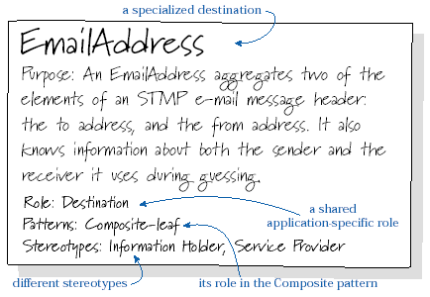
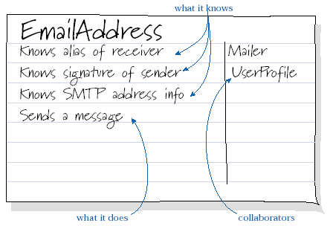
CRC Cards
Beck, K. and Cunningham, W. (1989) ‘A laboratory for Teaching Object Oriented Thinking’, Conference proceedings on Object-oriented programming systems, languages and applications, pp. 1–6. doi:10.1145/74877.74879.
Wirfs-Brock, R. and Wilkerson, B. (1989) ‘Object-oriented design: A responsibility-driven approach’, Conference proceedings on Object-oriented programming systems, languages and applications, pp. 71–75. doi:10.1145/74877.74885.

Slide 42
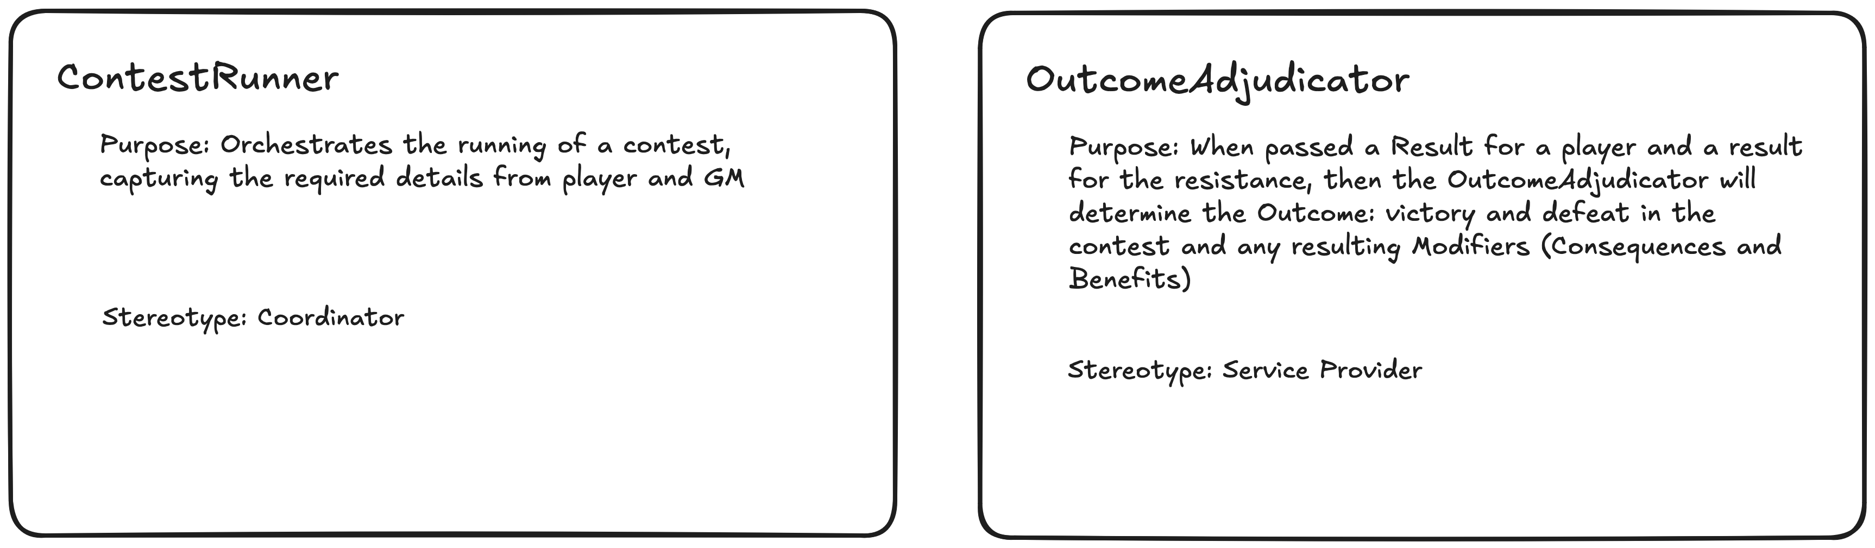
Step 3 – Find Candidates
Notes:
Name roles by what they do, not what they are. Look for verbs, not nouns.

Slide 43
Step 4 – Assign Responsibilities
Use Case Scenario: Frame a Contest
The GM creates a contest.
The GM notes the resistance and sets the prize or stakes for the contest.
The GM sets the resistance Target Number for that contest.
The player determines the PC's ability to overcome the resistance and gain the prize.
The GM determines if the ability has a stretch modifier.
The player identifies any relevant modifiers from augments.
The player identifies any relevant modifiers from hindrances.
The GM determines any situational modifiers.
Notes:
Responsibilities come from the behaviours described in use cases (user stories). Note that use cases don’t contain design details.
Use the “knows/does/decides” frame to assign responsibilities
Keep responsibilities concise and focused
Focus on distributing work—not centralizing it

Slide 44
Step 4 – Assign Responsibilities
Use the “knows/does/decides” frame to assign responsibilities
Keep responsibilities concise and focused
Focus on distributing work, not centralizing it
Notes:
Responsibilities come from the behaviours described in use cases (user stories). Note that use cases don’t contain design details.
Use the “knows/does/decides” frame to assign responsibilities
Keep responsibilities concise and focused
Focus on distributing work—not centralizing it

Slide 45
Step 4 – Assign Responsibilities
Stereotypes help you characterize the roles objects play:
Service Providers do things
Interfacers translate requests and convert between levels of abstraction
Information Holders know things
Controllers direct activities
Coordinators delegate work
Structurers manage object relations or organize collections of objects
Notes:
Responsibilities come from the behaviours described in use cases (user stories). Note that use cases don’t contain design details.
Use the “knows/does/decides” frame to assign responsibilities
Keep responsibilities concise and focused
Focus on distributing work—not centralizing it

Slide 46
Step 4 – Assign Responsibilities
ContestRunner – does the job of facilitating the contest
ContestHistory – knows the history of previous contests
DiceRoll – knows the score of a dice roll
DiceRoller – does the job of rolling a D20
Modifier – knows the adjustment to the PC’s target number
Outcome – knows degrees of victory or defeat
OutcomeAdjudicator – does the job of evaluating the contest outcome
Participant – knows an actor in the contest
Prize – knows the stakes of the contest
Result – knows the dice roll and successes
ResultCalculator – knows how to turn a dice roll into a result
SessionMaker – does the job of managing the creation and tracking of sessions
Successes - knows the number of successes from a dice roll
TargetNumber – knows the number you need to roll on a D20 to succeed
Notes:
Responsibilities come from the behaviours described in use cases (user stories). Note that use cases don’t contain design details.
Use the “knows/does/decides” frame to assign responsibilities
Keep responsibilities concise and focused
Focus on distributing work—not centralizing it

Slide 47
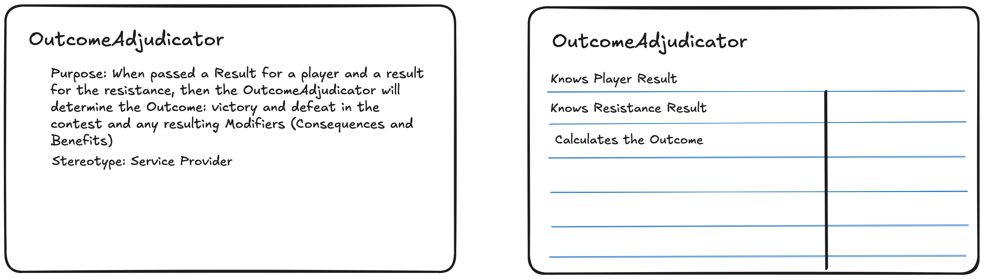
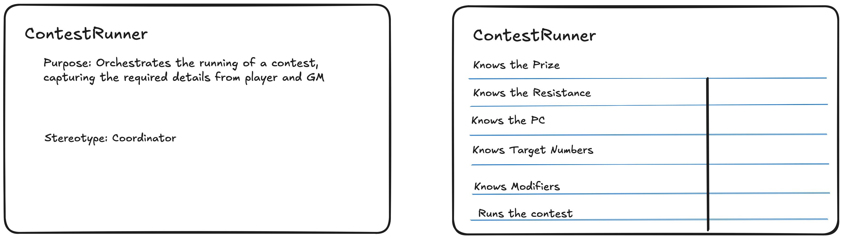
Step 4 – Assign Responsibilities
Notes:
Name roles by what they do, not what they are. Look for verbs, not nouns.

Slide 48

Step 5 – Sketch Collaborations
Show how these roles work together to fulfil the story
Look at an object’s stereotype, does it imply collaborations?
Examine individual responsibilities and consider what collaborations might be necessary.
If a responsibility is complex, can you break it up into smaller, closely collaborating objects?
How do objects fulfil a given responsibility?
Identify applicable design patterns.
Identify architectural choices
Simplify.
Notes:
Responsibilities come from the behaviours described in use cases (user stories). Note that use cases don’t contain design details.
Use the “knows/does/decides” frame to assign responsibilities
Keep responsibilities concise and focused
Focus on distributing work—not centralizing it

Slide 49
Step 5 – Sketch Collaborations
Information Holders: responsible for knowing facts; only tend to collaborate for serialization/deserialization (SerDes)
Structurer: structure and organise information (composition and aggregation).
Collaborations for SerDes
Collaboration with contained objects
Often, collaboration is needed to preserve invariants across a structure
Service Provider: responsibility for a computation or special skill. Collaboration with configuration; may have different implementations
Notes:
Responsibilities come from the behaviours described in use cases (user stories). Note that use cases don’t contain design details.
Use the “knows/does/decides” frame to assign responsibilities
Keep responsibilities concise and focused
Focus on distributing work—not centralizing it

Slide 50
Step 5 – Sketch Collaborations
Controllers: objects that make decisions and direct the actions of others
Collaborate with the sources of information that they use to make decisions from
Collaboration with the objects they instruct to act
Coordinators: objects that pass on the information others use to act
Collaboration with sources
Collaborates with sinks
Interfacers: form a bridge between neighbourhoods.
Collaboration with its neighbourhood and other neighbourhoods
Notes:
Responsibilities come from the behaviours described in use cases (user stories). Note that use cases don’t contain design details.
Use the “knows/does/decides” frame to assign responsibilities
Keep responsibilities concise and focused
Focus on distributing work—not centralizing it

Slide 51
Step 5 – Sketch Collaborations
SessionManager uses ContestRunner to facilitate contests
ContestRunner uses Participant to record the participants
Participant uses TargetNumber and Modifer to record the rating
ContestRunner uses OutcomeAdjudicator to orchestrate determining the Outcome.
OutcomeAdjudicator uses ResultCalculator to get the Result of the roll
ResultCalculator uses DiceRoller to roll the dice and produce a DiceRoll
ResultCalculator determines the Result of the DiceRoll and TargetNumber
Result knows the degree of Successes and the DiceRoll
OutcomeAdjudicator compares the Result for the Participants to determine the Outcome
Notes:
Responsibilities come from the behaviours described in use cases (user stories). Note that use cases don’t contain design details.
Use the “knows/does/decides” frame to assign responsibilities
Keep responsibilities concise and focused
Focus on distributing work—not centralizing it

Slide 52
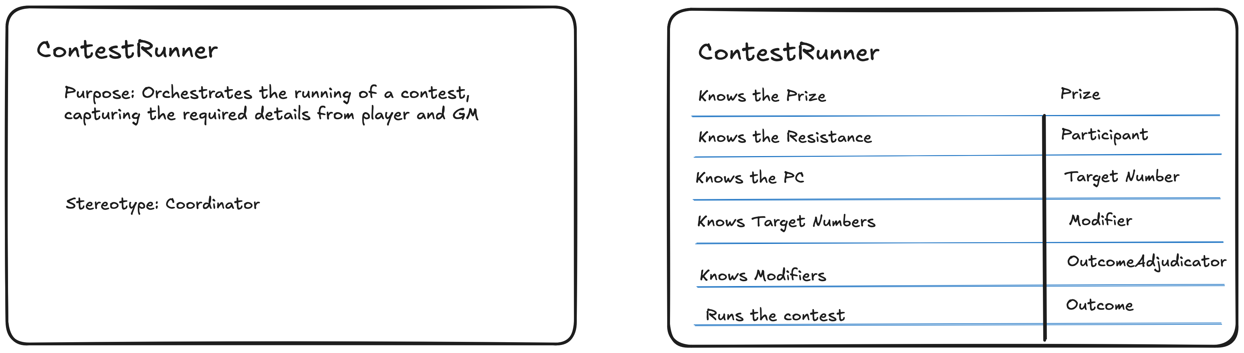
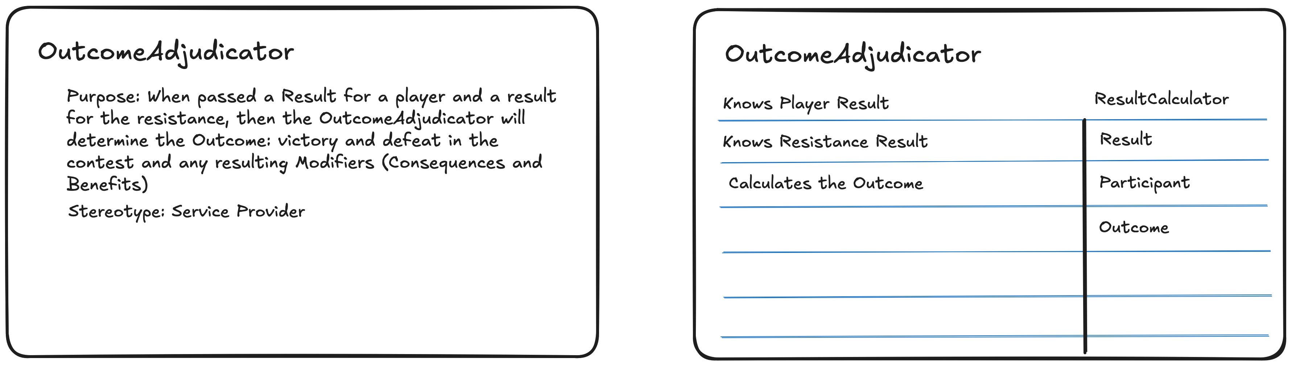
Step 5 – Sketch Collaborations
Notes:
Describe how roles interact. Who asks whom to do what? Keep it conversational.

Slide 53
Step 6 – Simulating Collaborations
Notes:
Turn roles into cards. Each card holds responsibilities and collaborators. Good for group work.

Slide 54
Step 6 – Simulating Collaborations
Preparing
Set a goal (what flow)
Set boundaries (limits of the simulation – for example, domain not adapters)
Notes:
Responsibilities come from the behaviours described in use cases (user stories). Note that use cases don’t contain design details.
Use the “knows/does/decides” frame to assign responsibilities
Keep responsibilities concise and focused
Focus on distributing work—not centralizing it

Slide 55
Step 6 – Simulating Collaborations
Preparing
Assign candidates
Participants role-play as one or more candidates. A candidate says what role they perform when asked, what they need to know to do that & how they know it. Collaborations are the flow between them.
Simulate the use cases
Use cases are conversations with the system
Add controllers as needed.
Notes:
Responsibilities come from the behaviours described in use cases (user stories). Note that use cases don’t contain design details.
Use the “knows/does/decides” frame to assign responsibilities
Keep responsibilities concise and focused
Focus on distributing work—not centralizing it

Slide 56
Step 6 – Simulating Collaborations
Notes:
Turn roles into cards. Each card holds responsibilities and collaborators. Good for group work.

Slide 57
Step 6 – Simulating Collaborations
Running
Your goal is to test the model, make sure required roles are allocated, and that collaborations are understood.
Start with an "event" that represents user intention [In Ports & Adapters, the call at a port]
Who receives it?
Are we missing an object? (No receiver).
Does the receiver have the responsibility to handle it?
Who will collaborate with it to fulfil its responsibility?
Notes:
Responsibilities come from the behaviours described in use cases (user stories). Note that use cases don’t contain design details.
Use the “knows/does/decides” frame to assign responsibilities
Keep responsibilities concise and focused
Focus on distributing work—not centralizing it

Slide 58
Step 6 – Simulating Collaborations
Follow the sequence of collaborations
Toss a ball between each other
As we simulate, we run into problems that require new candidates or need us to split or merge existing candidates.
Be critical. Ask how someone has the knowledge they need, if that responsibility expresses what is being asked, if intelligence is being distributed.
Notes:
Responsibilities come from the behaviours described in use cases (user stories). Note that use cases don’t contain design details.
Use the “knows/does/decides” frame to assign responsibilities
Keep responsibilities concise and focused
Focus on distributing work—not centralizing it

Slide 59
Step 7 – Choose a Control Style
Notes:
Choose how logic flows. Who’s in charge? What’s delegated? Consider maintainability.
Teach: Pick a control style that fits the scenario
Centralized, dispersed, delegated
Use THE EXAMPLE to illustrate the implications of control decisions
Reflect briefly on trade-offs

Slide 60
Step 8 – Evolve the Model
RDD is iterative—refactor as new insights emerge:
Hence, we use the term "Candidate" at this stage.
Encourage:
Splitting overly large roles
Introducing new stereotypes
Revisiting collaborators or contract boundaries
Names Matter:
Follow the ubiquitous language of the domain
Would Framer be better than ContestRunner?
Would Referee be better than OutcomeAdjudicator?
Refactoring our names may lead to greater insight
In essence this is DDD, at this point
Notes:
Responsibilities come from the behaviours described in use cases (user stories). Note that use cases don’t contain design details.
Use the “knows/does/decides” frame to assign responsibilities
Keep responsibilities concise and focused
Focus on distributing work—not centralizing it

Slide 61
Summary – What We Built
Behavioral model
Responsibilities and Collaborations defined
Notes:
Recap what a website that runs one-on-one QuestWorlds contests taught us. We built a model based on domain behavior, not structure.
Recap what was accomplished:
A behavior-centered model, not just a set of classes
Explicit responsibilities and collaborations
A model that supports the domain’s real needs
Bridge to next section: “Now let’s look at how this fits with practices like TDD and Agile.”

Slide 62
RDD TODAY
How were you ever able to do DDD without it?

Slide 63
TDD: Behaviors, Not Methods
TDD explores and verifies behaviors
Each test expresses a business behavior
Don’t test methods—test responsibilities
RDD helps define those behaviors
Define responsibilities before coding
Each responsibility maps to testable behavior
Notes:
Urge the audience to test behaviors, not individual methods. This drives better design.
Teach:
Each test should express a business or domain behavior
RDD encourages behavior-first thinking: “What should this object be responsible for?”
Anti-pattern: writing a test for every method
Better: write tests that reflect what the object should do in context
Example prompt: “If this object plays the ‘coordinator’ role, what’s its responsibility under failure?”

Slide 64
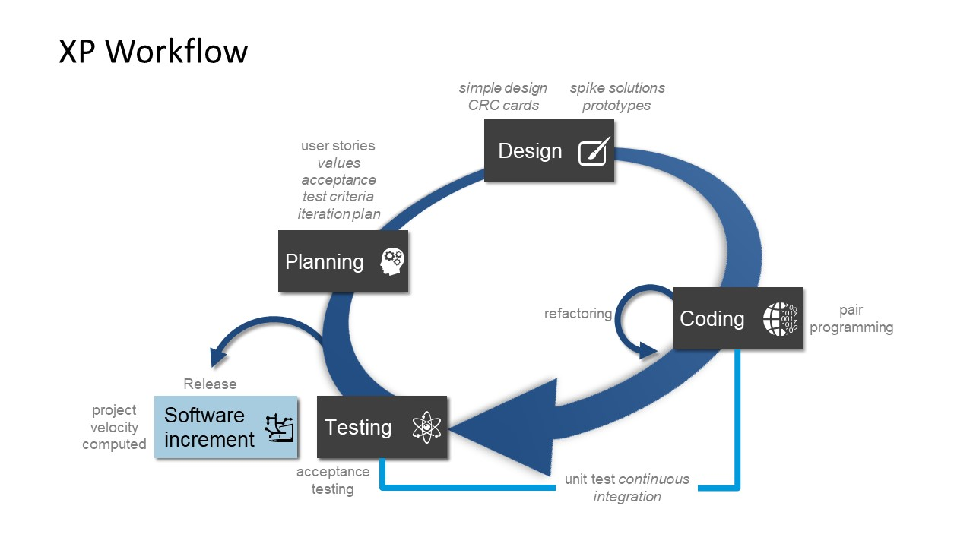
RDD in Agile Teams
Notes:
RDD fits well in story-level discussions. CRC sessions are light, collaborative, and focused.
Teach: RDD works well in:
Collaborative design workshops
Story-level modeling (What roles do we need to fulfill this story?)
Fits well with agile modeling values: simple, communicative, evolutionary
Elaboration: Story-level modeling
Collaborative workshops with CRCs
Mob Programming as Simulation

Slide 65
Collaborating with an LLM as a Design Assistant
Use prompts to explore responsibilities and roles
Examples:
- 'Help me write a design story for this feature'
- 'Suggest roles and responsibilities based on this design story'
- 'Generate CRC cards for these candidates’
- ’Suggest collaborations between these candidates’

Slide 66
Try This in Your Next Project
Model a story with CRC cards
Ask: What should this object be responsible for?
Write tests for behaviors—not methods
Notes:
Offer actionable tips: CRC cards, behavior-driven tests, ask what each object should be responsible for.
Teach: Give 2–3 actionable takeaways:
Try modeling a story with CRC cards
Ask: “What should this object be responsible for?”
Write a test that describes a behavior, not a method
Use object stereotypes to critique an existing design

Slide 67
https://wirfs-brock.com/rebecca/books/

